Slide 1
Logical connectives (Use WWL Chen : Discrete Mathematics)
Proposition: sentence that is true or false.
State proposition that are true and false.
When a statement cannot be logically broken into smaller statements, we call it atomic.
For example, p, q, the-sky-is-cloudy, are examples of atomic propositions.
A proposition can assume a binary valuation space, i.e.for a proposition p, its valuation space v (p) ∈ {0,1}.

Slide 2
Words that express logical connectives in English
"and" - conjunction.
"and then" - conjunction with sequencing.
"and then within" - conjunction with sequencing and time window requirement.
"or" - disjunction.
"either...or" - exclusive disjunction.
"implies" – implication.
"if...then" - implication.
"if and only if" - equivalence.
"only if" - implication.
"just in case" – biconditional.
"but" – conjunction.
"however" - conjunction.
"not both" - alternative denial.
"neither...nor" - joint denial.

Slide 3
Assign values to the following propositions
Give the truth values of the following sentences
The sun will rise tomorrow.
Jesus is coming next year.
What is your name?
Mice chase cats.
Cats chase mice.
A right angle is 90°.
Sit down!
Pigs do fly.

Slide 4
contd
We can combine or connect sentences to produce new sentences and determine whether the resultant sentence is true or false. The truth values of the new sentence depend on the truth values of the sentences that are being connected.
Ways of connecting sentences to form sentences:

Slide 5
Assigning Truth Values to sentences/propositions
Taking p and q to denote sentences: take T – True and F – False
propositional logic is composed of propositional symbols, logical connectives, and/or parenthesis.
Negation: P is True, : p for NOT: p is T if p is F and F if p is T
Disjunction: p ∨q for OR is T if at least one of the sentences are T and is F otherwise
Conjunction: p ∧q for AND is T if the two sentences are both T and is F otherwise
Conditional: p→q for IF THEN : is T if P is F or q is T or both and is F otherwise
Bi-conditional: p↔q for IF AND ONLY IF: T is both p, q are T or both F and are F otherwise

Slide 6
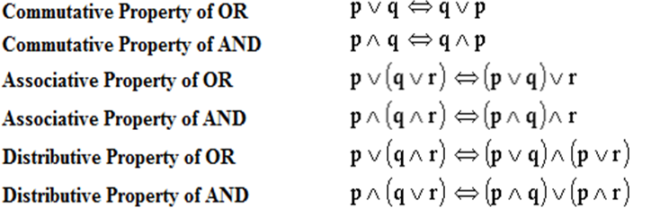
Draw the truth tables for these properties

Slide 7
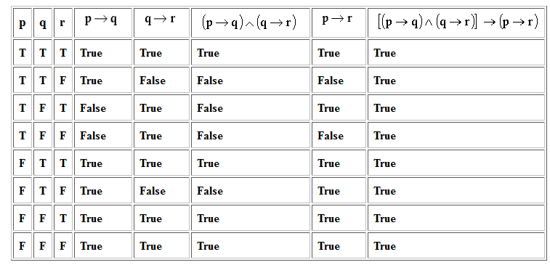
Tautology: Why?

Slide 8
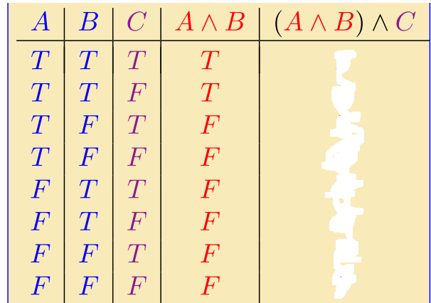
Investigate whether its a Tautology or not

Slide 9

construct a truth table for this sentence

Slide 10
Practice exercises
Investigate whether De Morgan’s laws are Tautologies or not
Show that the sentence p ∨ q is a Tautology
Show that the sentences : p→q and q → p are not logically equivalent.
Investigate whether the law of syllogism is a Tautologies or not.

Slide 11
More exercises
Copy and complete the truth table for the given statement and Indicate whether the statement the statement is a tautology or not.
1.
p | q | p Λ q | (p Λ q) → p

Slide 12
Contd
2.
p | q | p V q | (p V q) → p

Slide 13
contd
3.
p | q | ~ p | p V ~ p | q → (p V ~ p)

Slide 14
Important concepts in propositional logic
Tautology: A compound statement is a tautology if it is true regardless of the truth values assigned to its component atomic statements. eg, Either it is raining or it is not raining.
Contradiction: A compound statement is a Contradiction if it is false regardless of the truth values assigned to its component atomic statements. eg, It is raining and it is not raining.
Contingency: A compound statement is a contingent if it is true on some assignments of truth values to its component atomic statements, and false on others. eg, Willard is either a philosopher or a windbag, and he’s not a philosopher.
Inverse: The inverse is formed by negating the hypothesis and negating the conclusion. p → q: If you have a Sprite, then you have a root beer. ~ p → ~ q: If you do not have a Sprite, then you do not have a root beer.
Converse: The converse is formed by interchanging the hypothesis and the conclusion. p → q: If it rained, then the ground got wet. q → p: If the ground got wet, then it rained.
Contrapositive: The contrapositive is formed by negating both the hypothesis and the conclusion, and then interchanging the resulting negations. p → q: If 15 is an odd number, then 15 is a prime number. ~ q → ~ p: If 15 is not a prime number, then 15 is not an odd number.

